Slide 1

Carpark Forecasting
Data Science # batch-1175
Anaïs Etienne, Annett Behr, Reinis Brezinskis, Rémy Lefebvre

Slide 2

Objective
Forecast the number of cars that have a reserved space
Improve the financial results:
by increasing rates
and with discounts

Slide 3
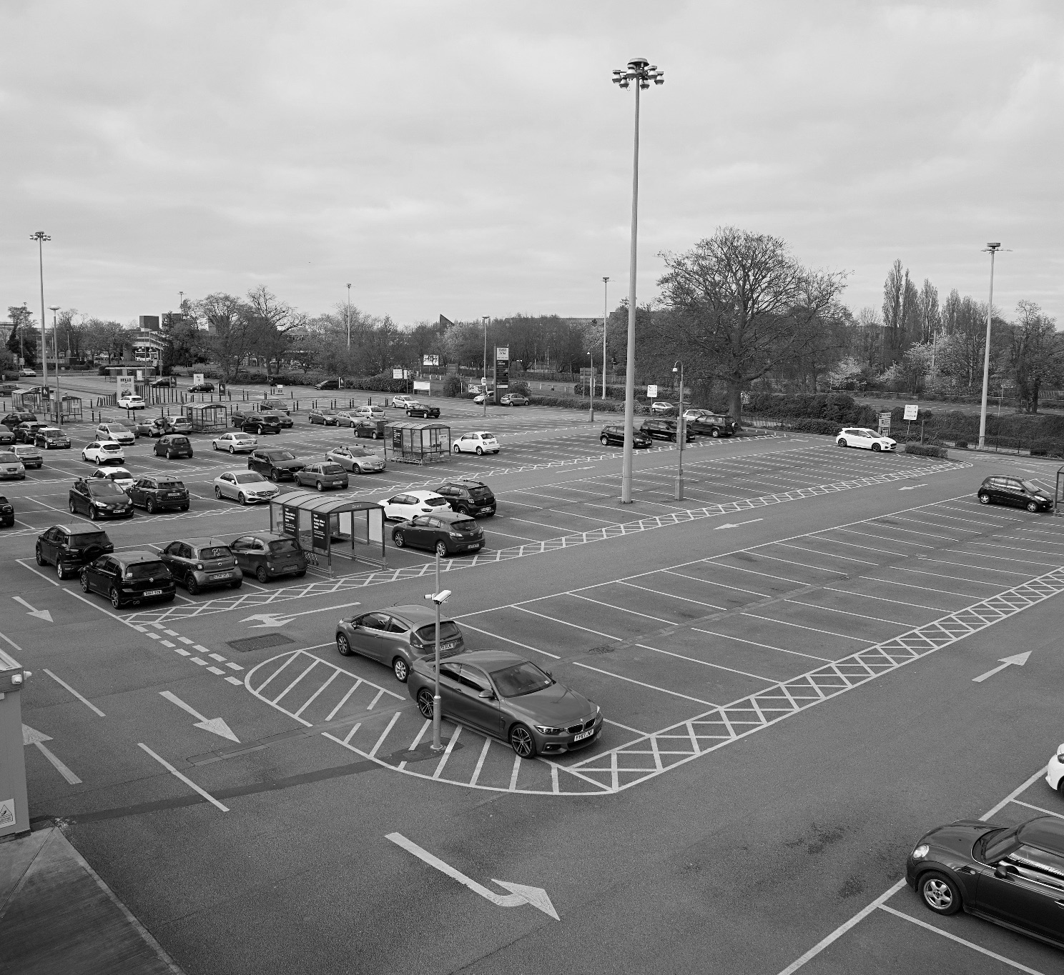
The Company
EFFIA
690 carparks in France & Belgium
Mainly in train stations & city center
200 carparks available for the reservation
The Dataset
Tabular dataset
18 features
43 carparks
+535k rows
From 2019 to June 2023

Slide 4
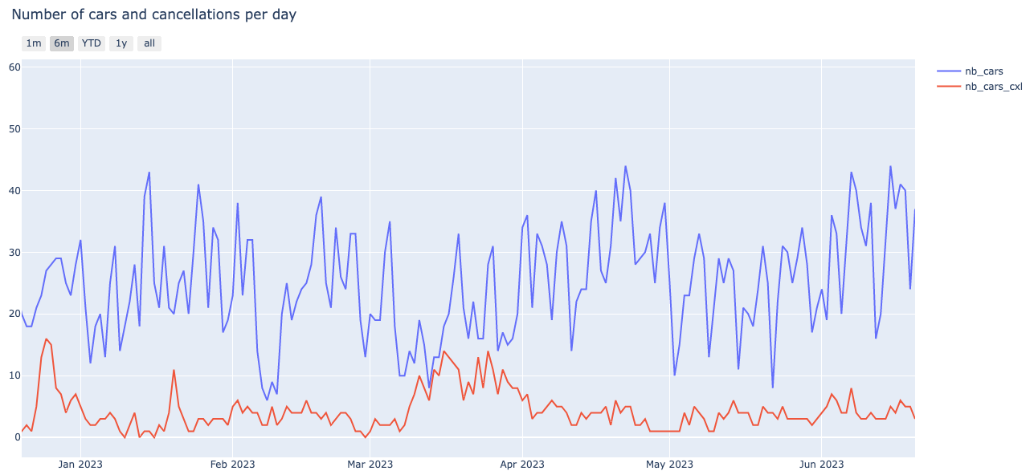
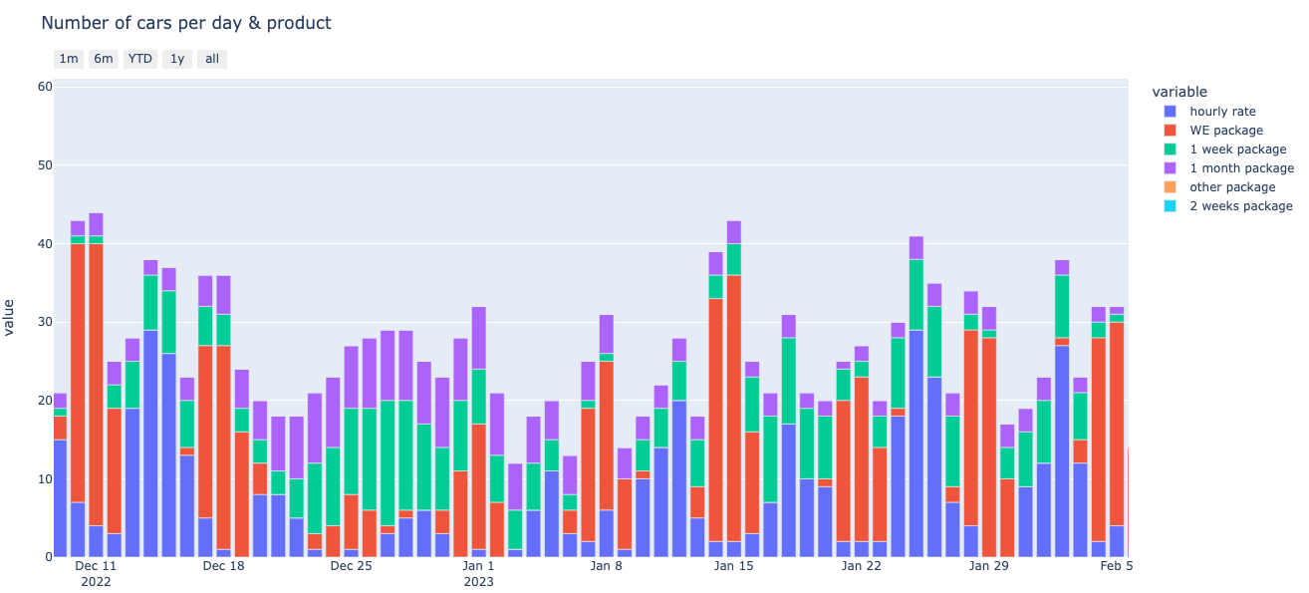
Trends
Strikes
exogenous factors added to the model:
strikes
holidays
vacations
Vacations
Weekend

Slide 5
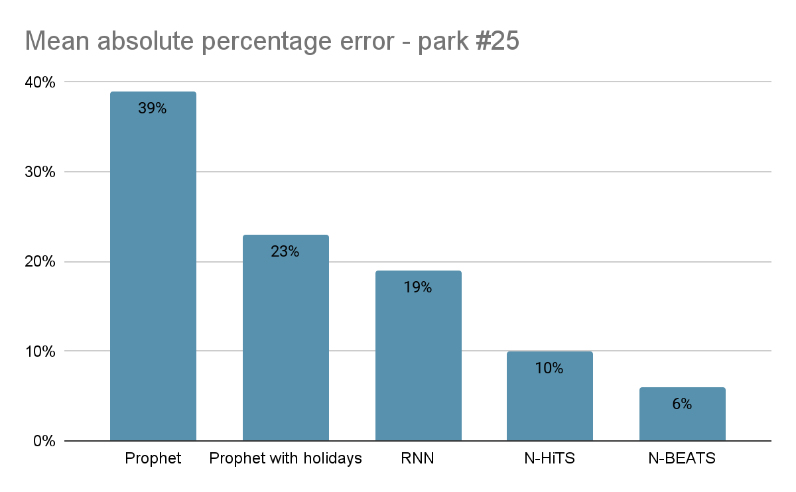
Time-series models for forecasting
1.
Prophet Model
fast baseline model
2.
RNN Model
captures temporal dependencies in sequential data
3.
N-HiTS
extension of N-BEATS
4.
N-BEATS
Neural Forecasting of a Multivariate Time Series with Complex Seasonality
>>> https://carparkforecast-6rpsqxljqfk.streamlit.app/ <<<

Slide 6
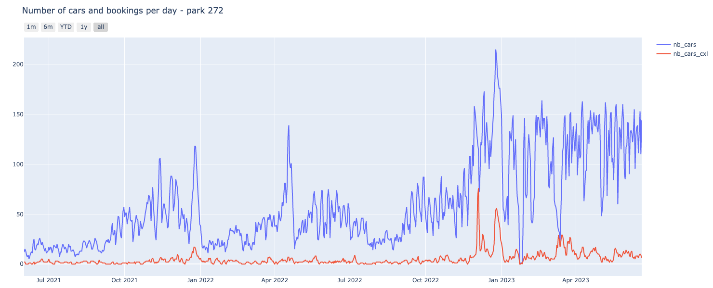
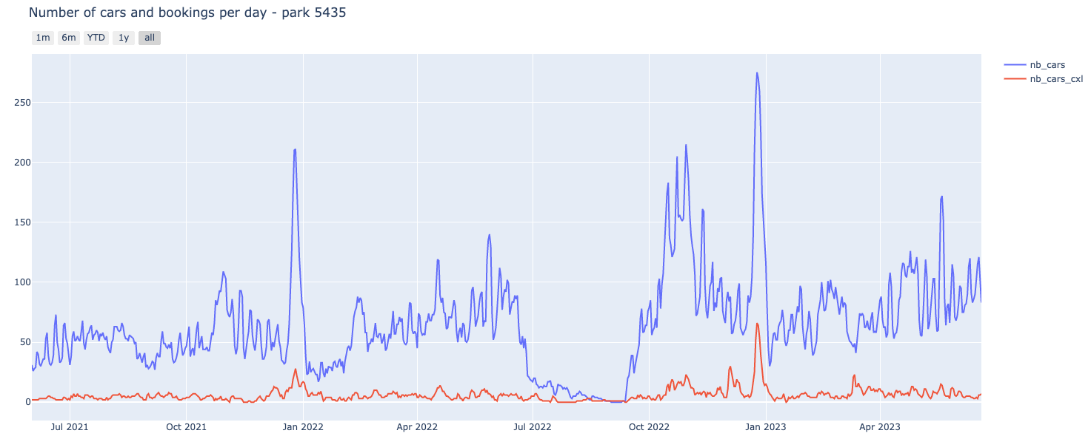
Difficulties
Pattern in general quite similar, but some exceptions:
change the nb of spaces
closing
increase nb of spaces available for bookings
closed for renovations

Slide 7

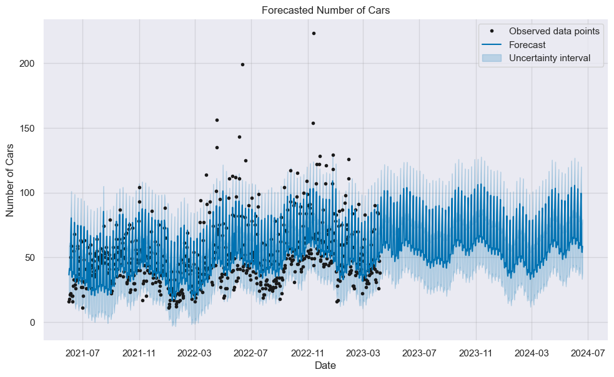
Next steps
Events in the past
Exogenous factors in the future
Forecast the products sold by day
Full prediction of occupancy: bookings and without bookings
Event
Event ?
Event ?
Event ?

